Slide 1
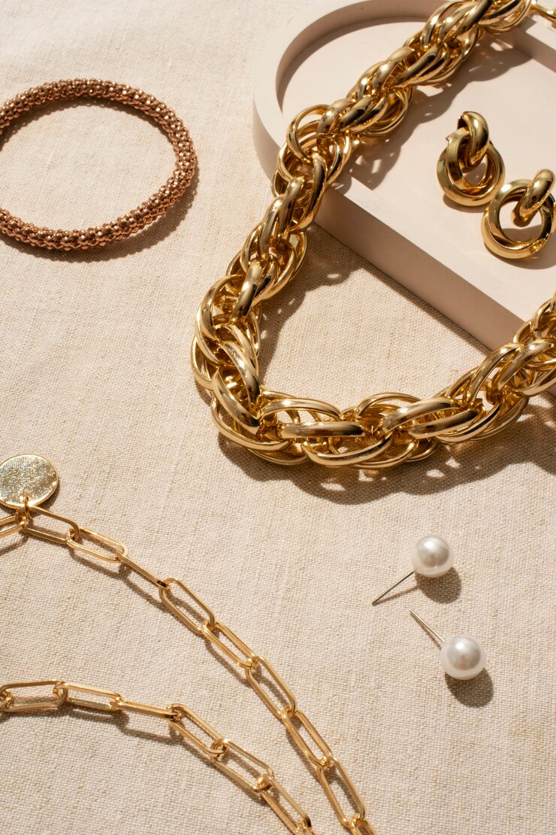

Slide 2

JEWELLERY E-COMMERCE PLATFORM
BUSINESS NAME: ECLAT JEWELS
MEANING: “SHINE” IN FRENCH
MISSION: PROVIDE A SEAMLESS & ENJOYABLE SHOPPING EXPERIENCE
PRODUCTS: BRACELETS, EARRINGS, RINGS, NECKLACES, CHAINS, WATCHES
TARGET AUDIENCE: WOMEN & MEN
MATERIALS: SILVER, STEEL, CUBIC ZIRCONIAS, CRYSTALS, ETC.

Slide 3
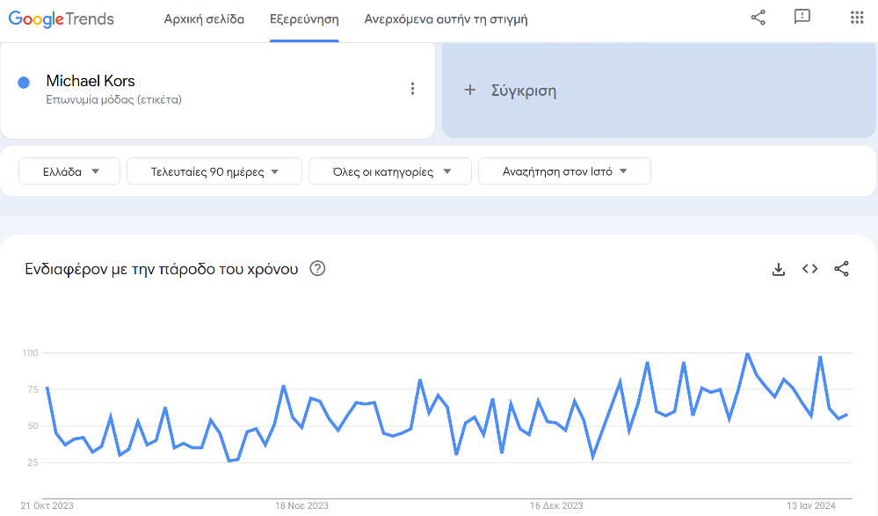
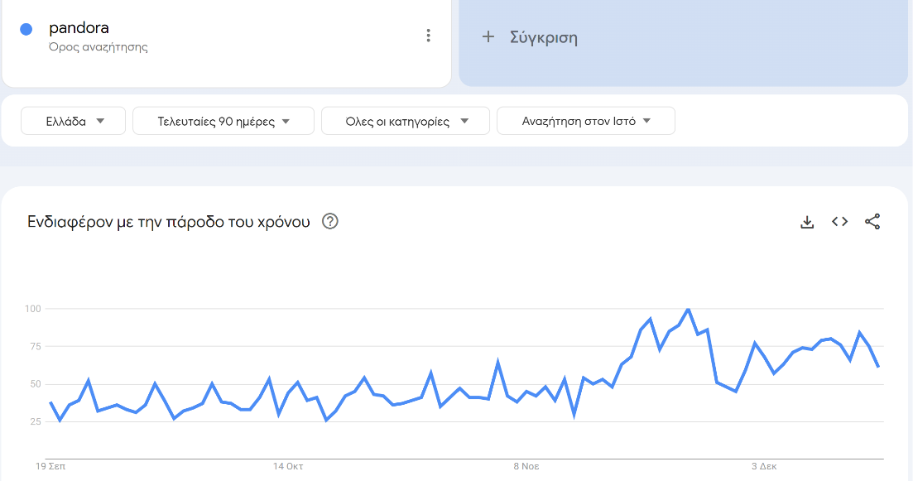
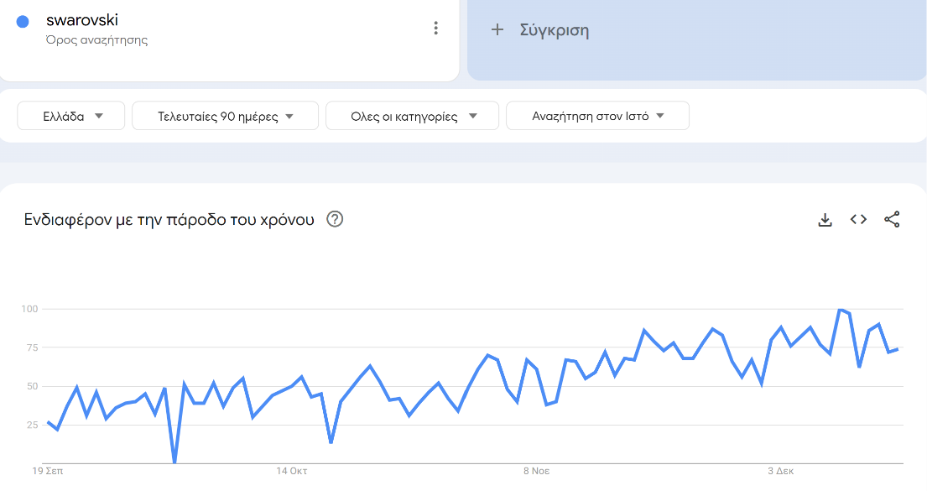
Brand Selection
BRANDS: Pandora, Swarovski, Michael Kors, Oxette, Bronzallure, Salvatore Plata, etc.
We used the Google Trends platform to verify their ongoing demand
Google Trends- Michael Kors
Google Trends- Pandora
Google Trends- Swarovski

Slide 4
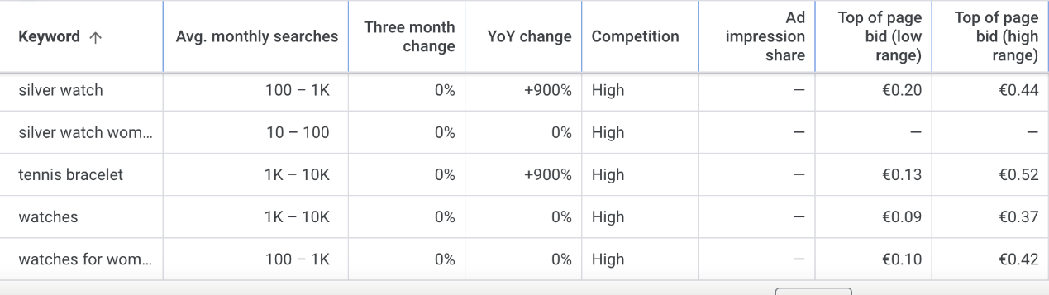
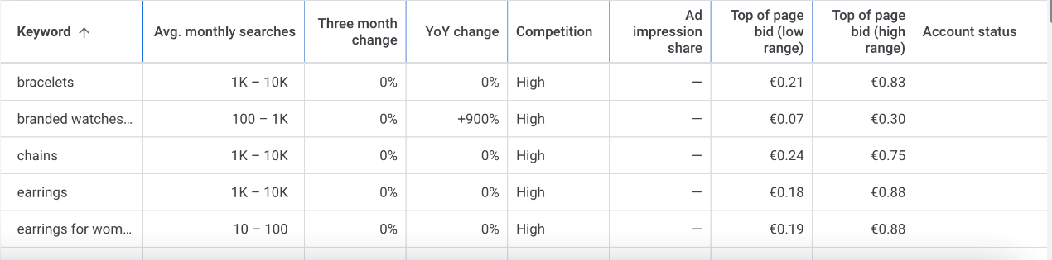
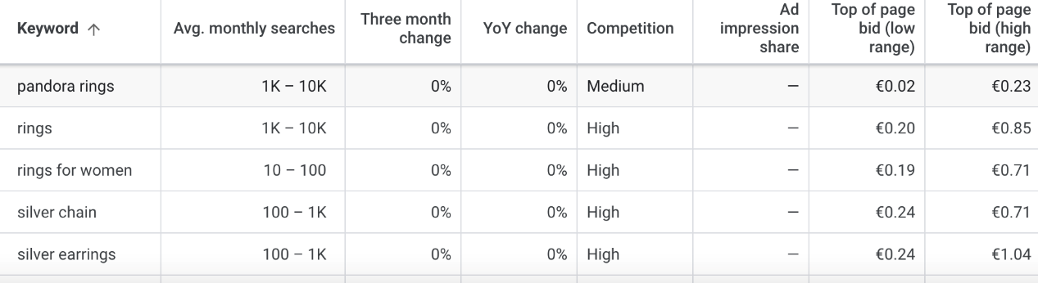
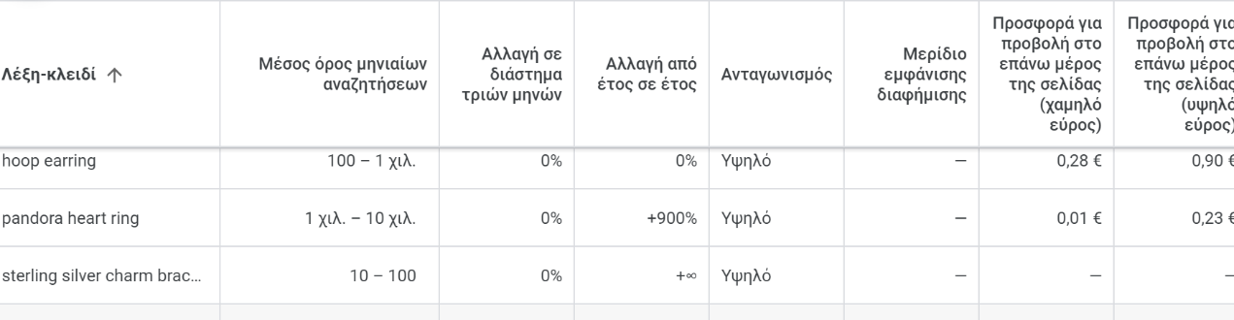
Keyword Research
1
Keywords aligning with our product offerings: Earrings, bracelets, rings, watches, chains
2
Modifiers such as “women’s jewellery” and “men’s jewellery”
3
Some long-tail keywords such as: sterling silver charm bracelet, silver watches for women, etc.

Slide 5

Competitor Analysis
1
Initial search in the google search engine
2
Top 5 Competitor identification: athinajewellers.gr, antwnakakis.gr, acrystalworld.gr, e-dazz.gr, pandorashop.gr
3
Use of SEMRUSH to conduct a more thorough analysis
4
Gained valuable insights for their top-searched brands, keywords and general online presence

Slide 6
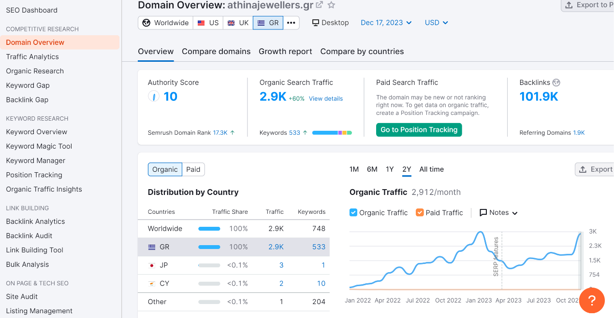
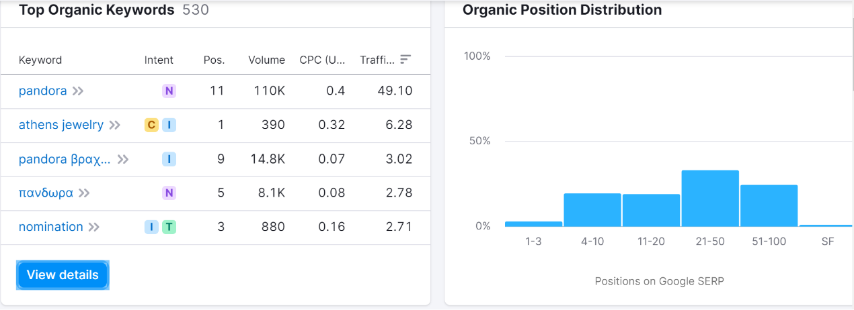
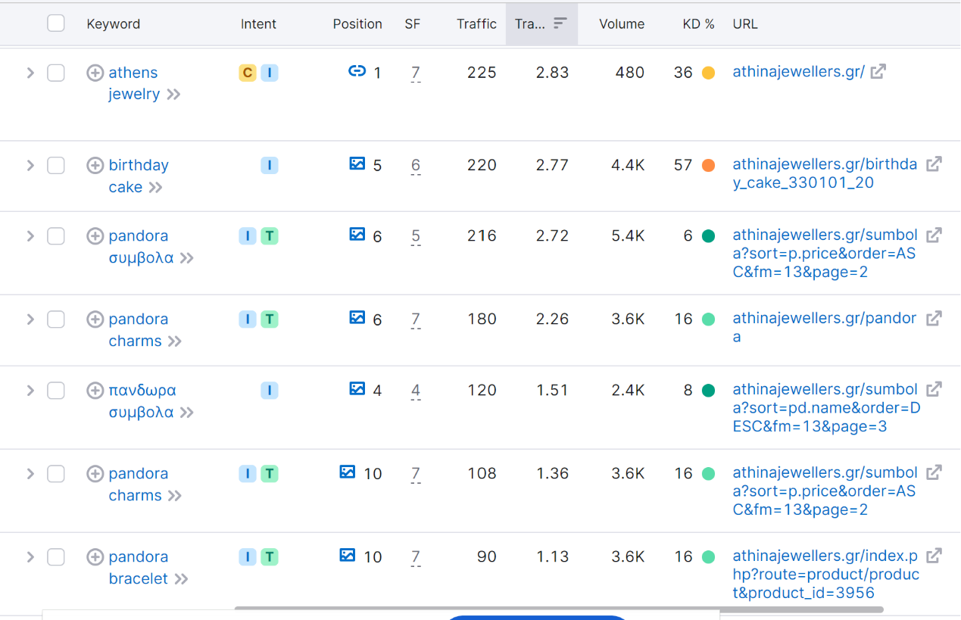
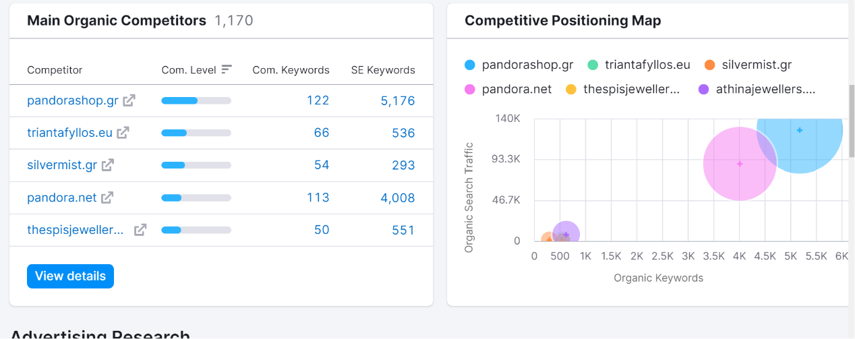
Competitor: athinajewellers.gr

Slide 7
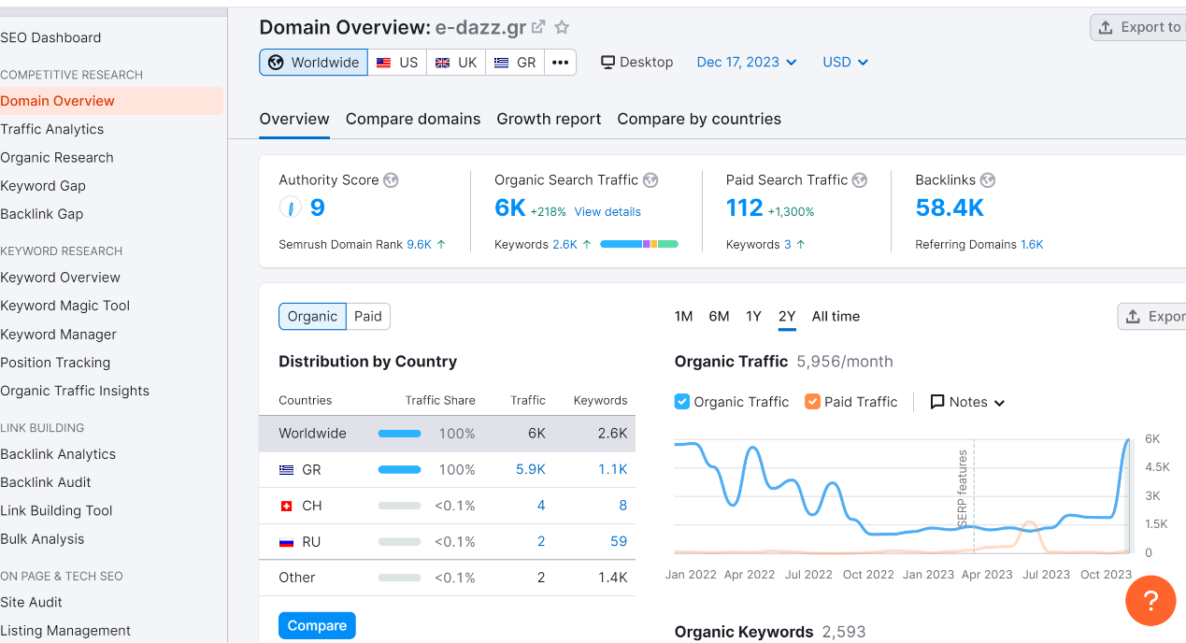
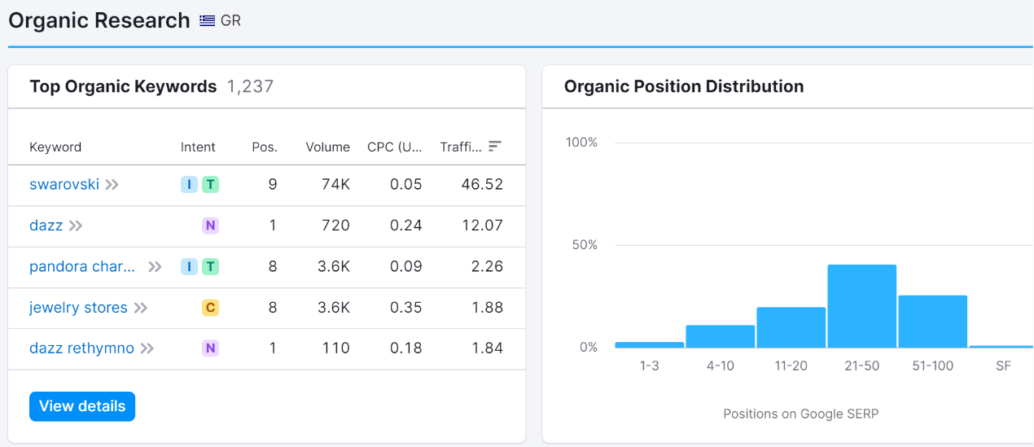
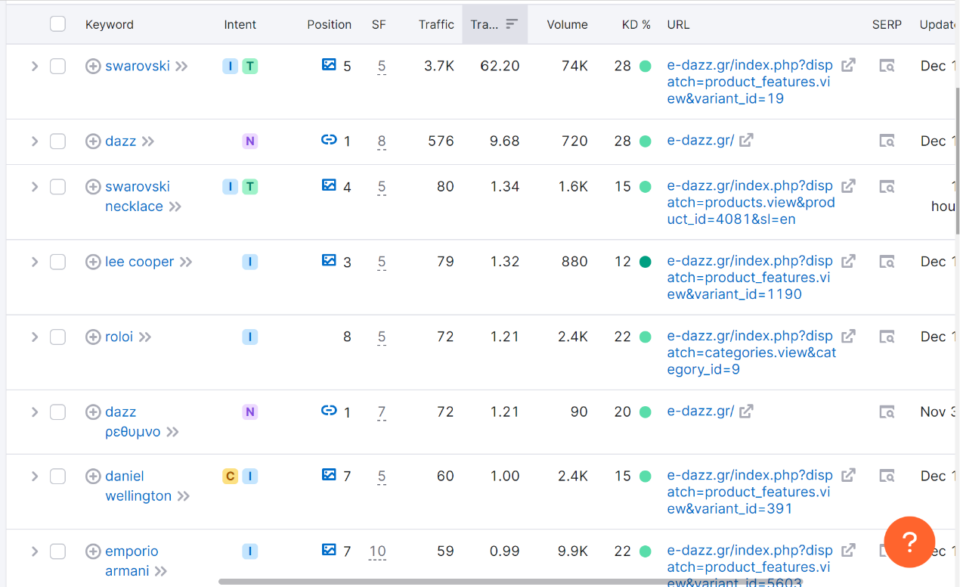
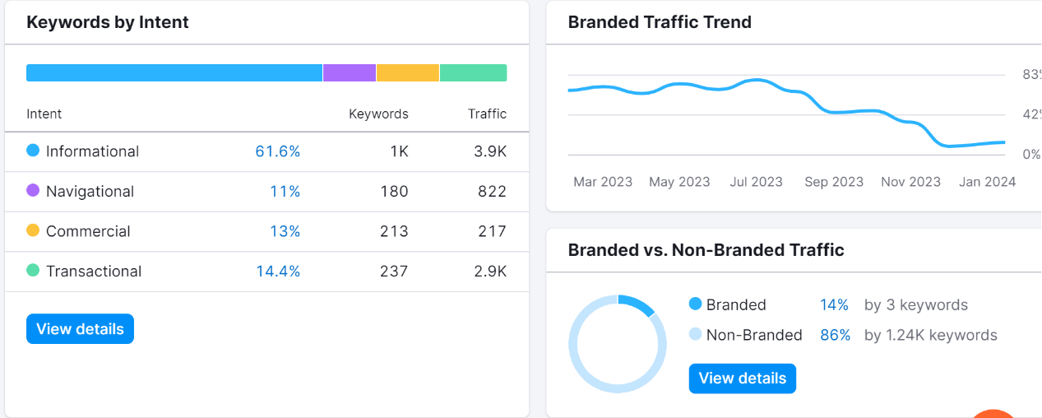
Competitor: e-dazz.gr

Slide 8
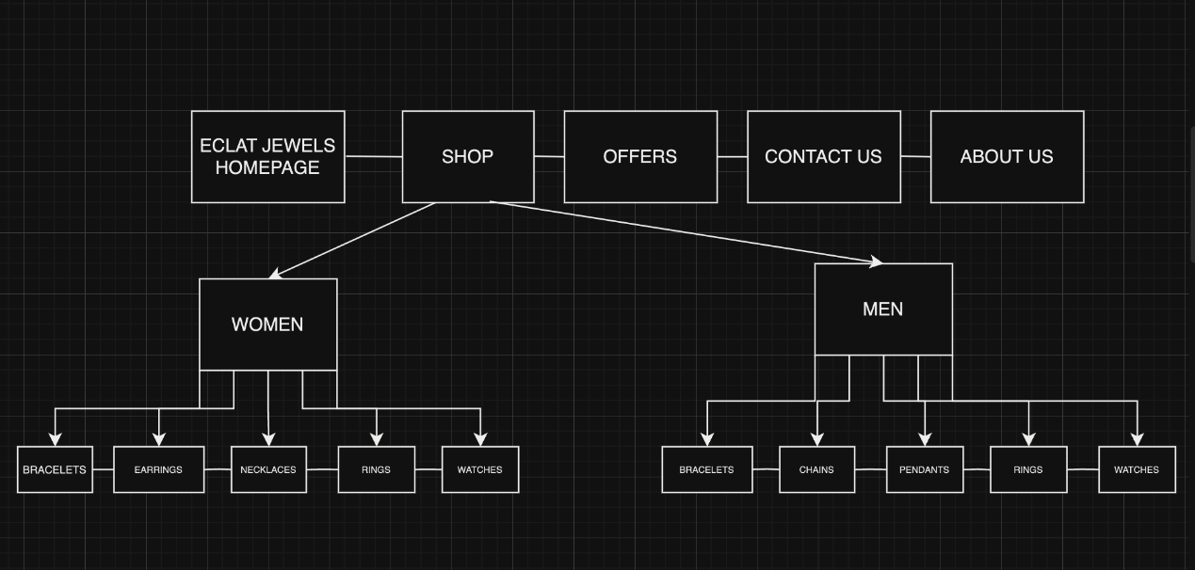
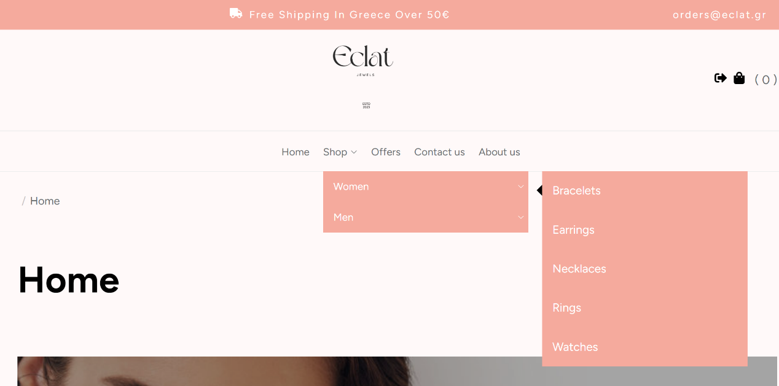
Building & Designing our website
1
We used the “Omega” theme
2
Defined our aesthetic using soft colors, elegant images, catchy phrases for the homepage
3
Used the SILO structure for easy and friendly-user navigation

Slide 9
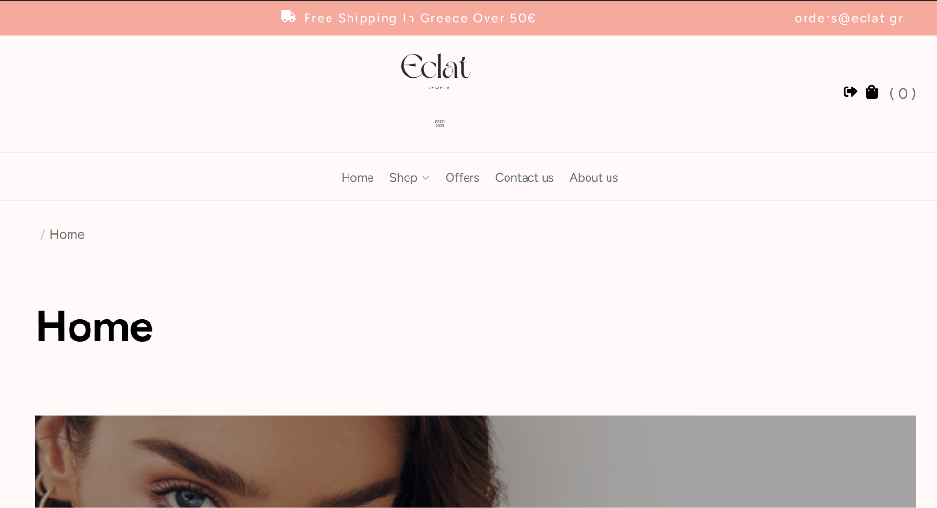
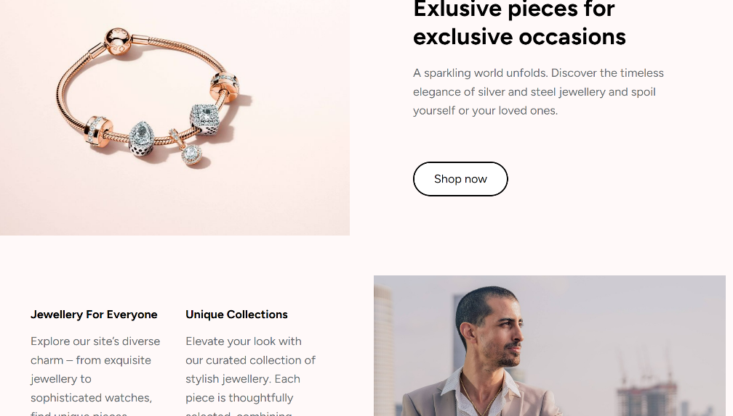
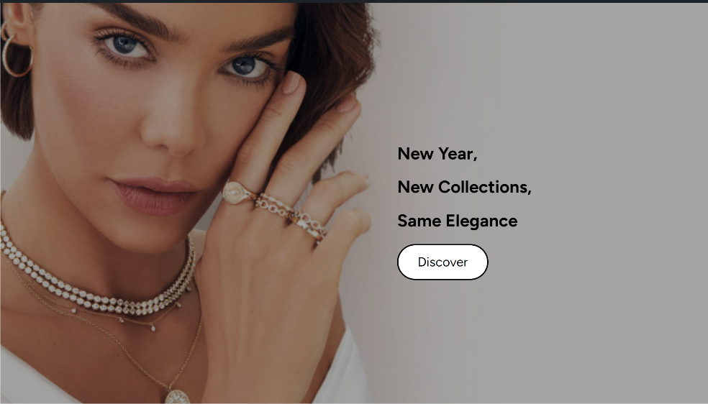
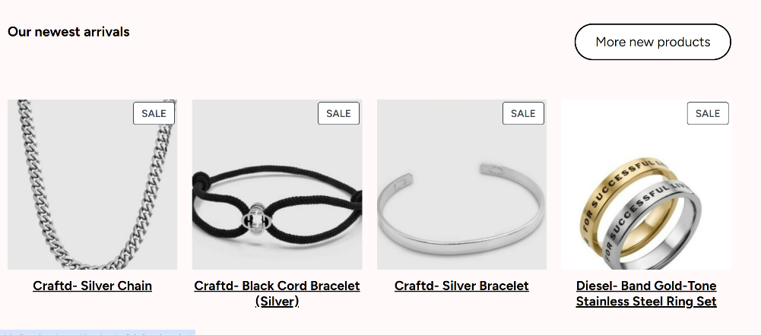
Eclat Jewels: Homepage
https://dmlabs.ihu.edu.gr/group1/

Slide 10
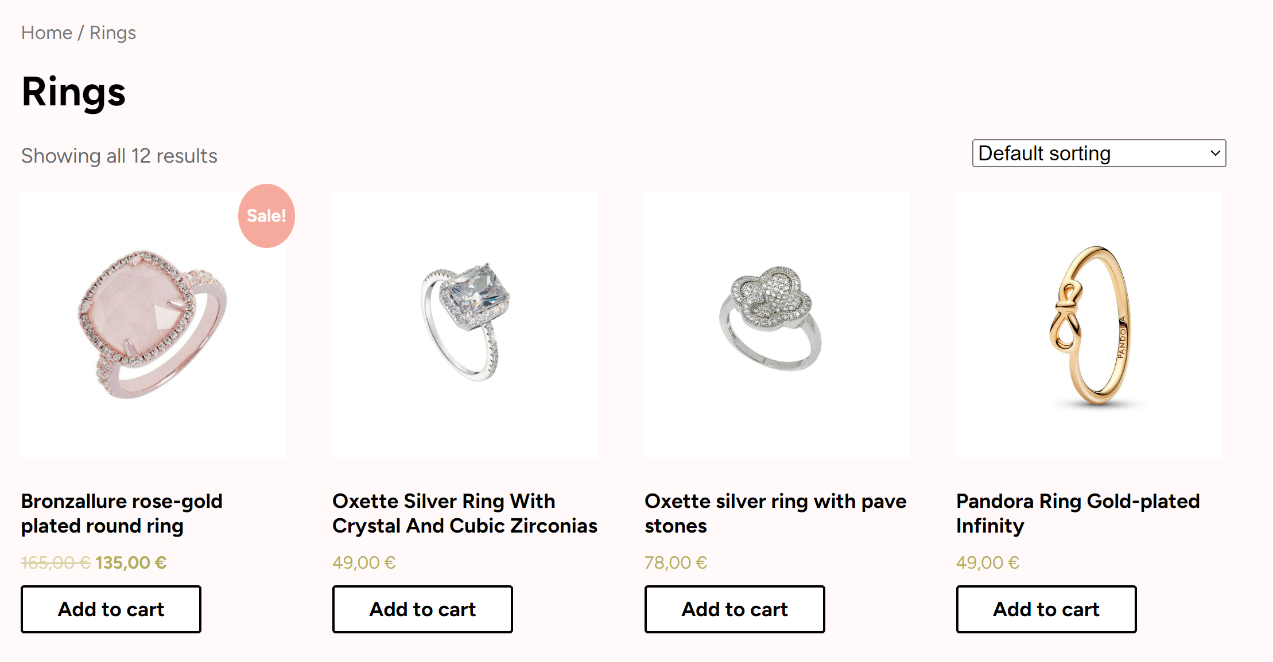
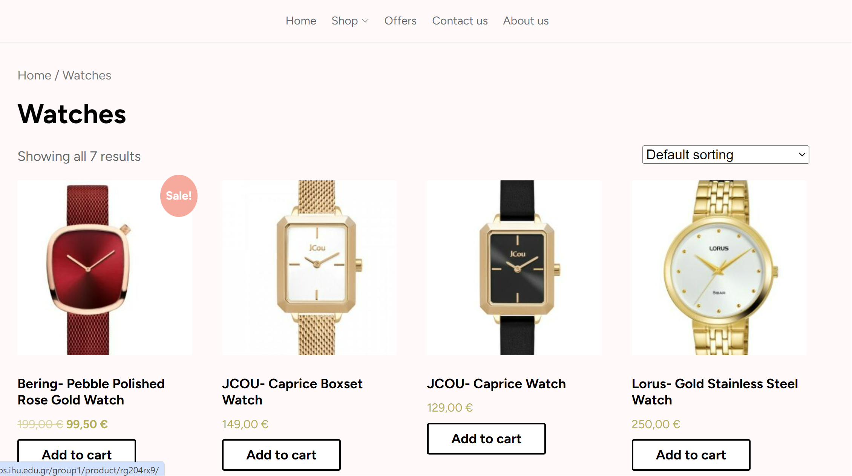
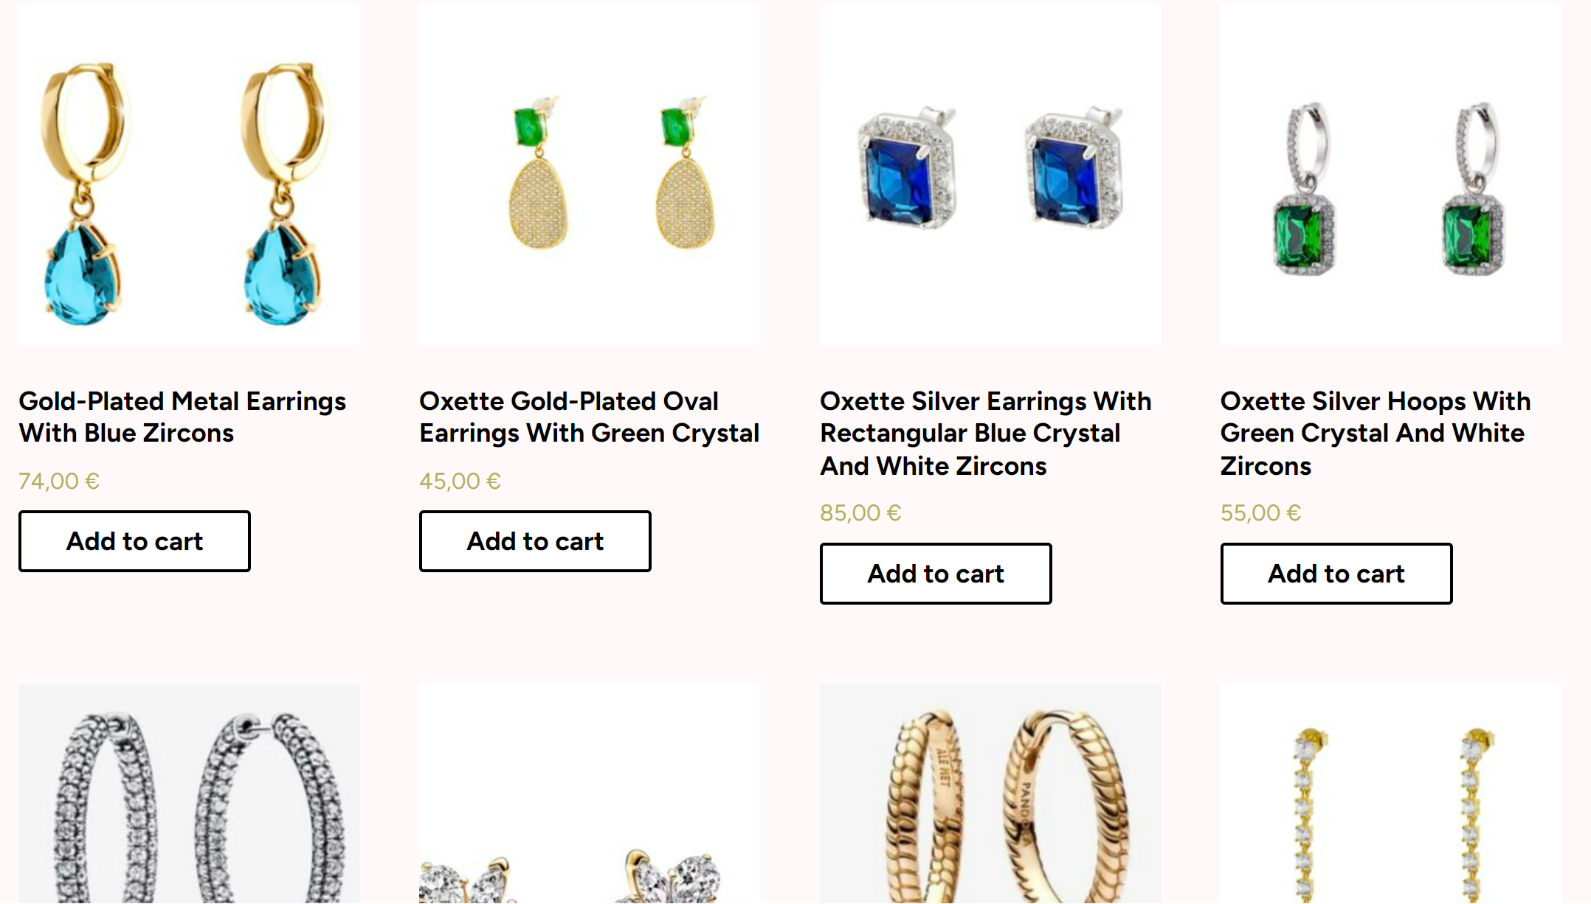
Eclat Jewels: Product Pages

Slide 11
SEO optimization
1
Using the YOAST plug-in
2
SEO: using our desired keyphrase, we optimized the text length, meta-descriptions and slugs, outbound links,
internal links, image SEO
3
Readability: enough active voice in the texts, the paragraph and sentence length were appropriate, transition words

Slide 12
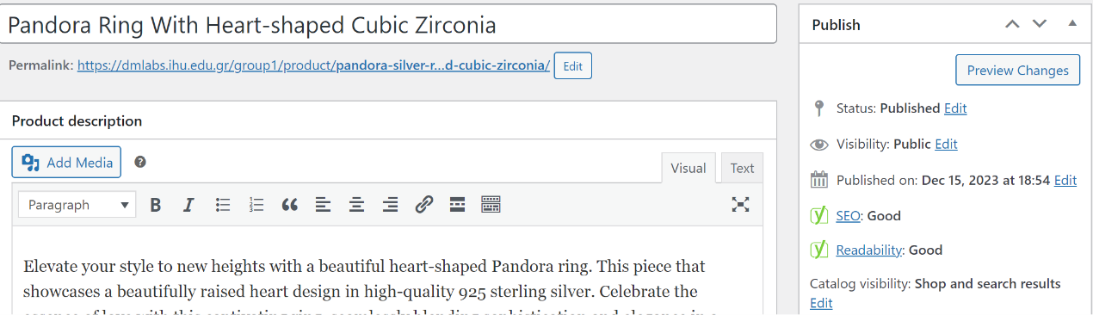
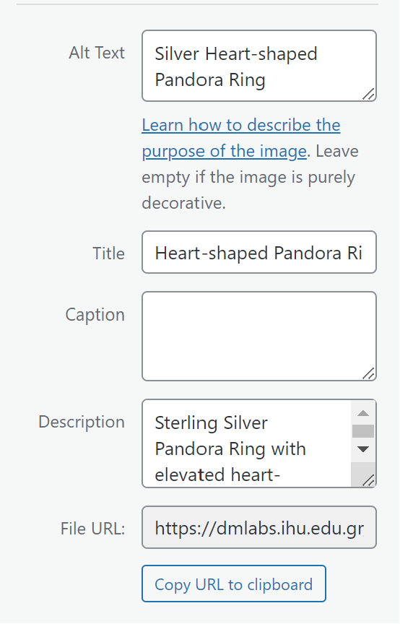
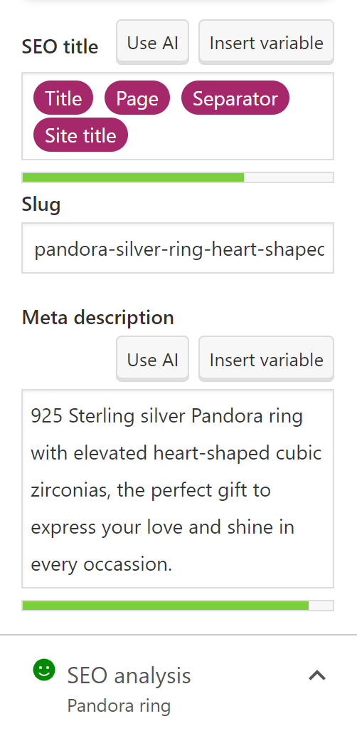
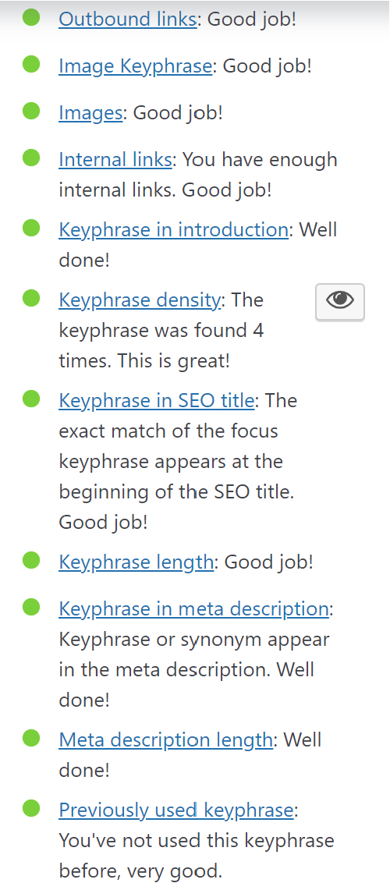
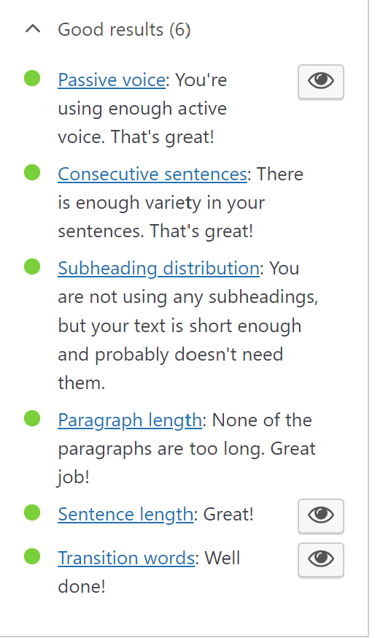
Image optimization
SEO & READABILITY SCORE
Silver heart-shaped Pandora ring
Readibility

Slide 13
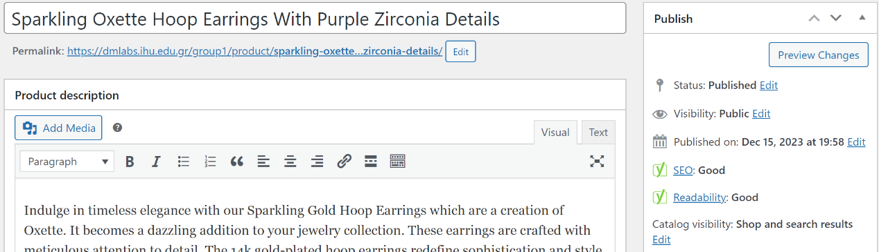
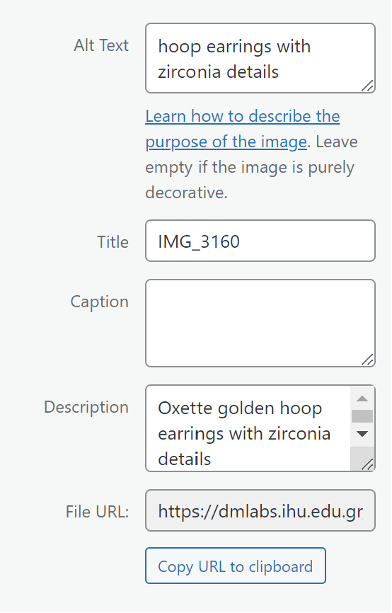
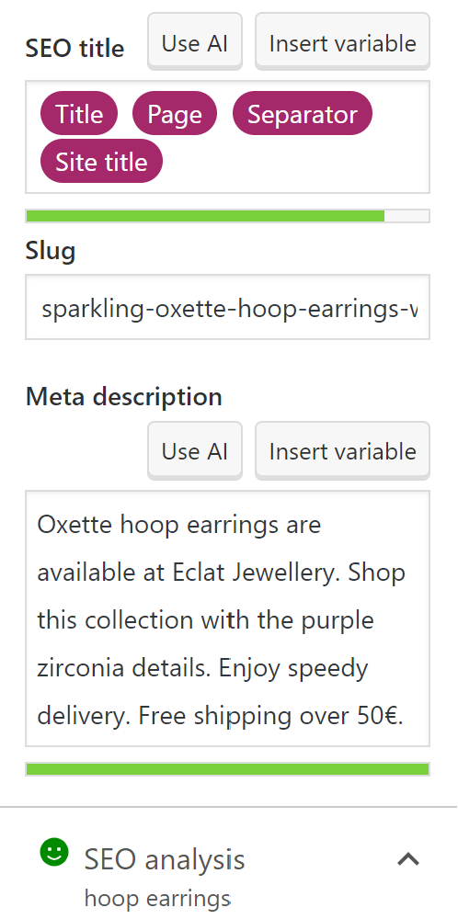
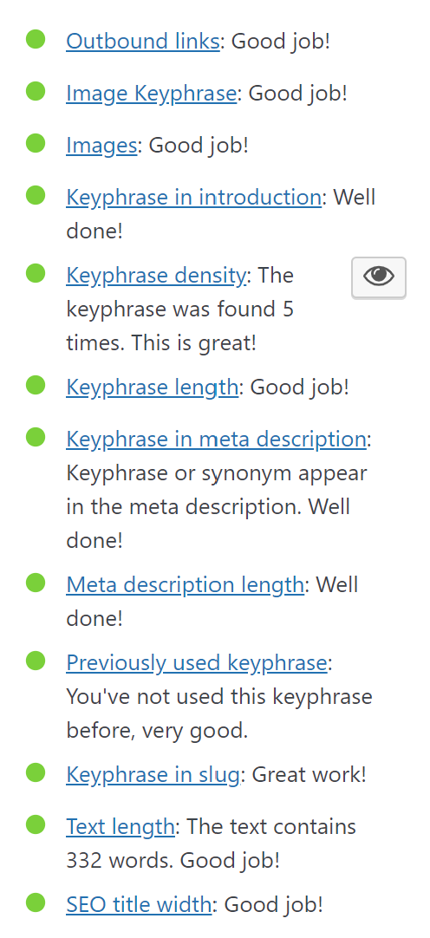
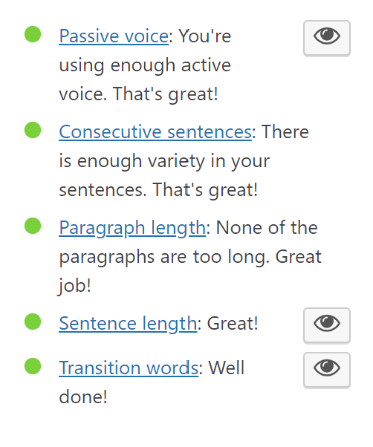
Image optimization
Readibility
SEO & READABILITY SCORE
Sparkling Oxette Hoop Earrings With Purple Zirconia Details

Slide 14
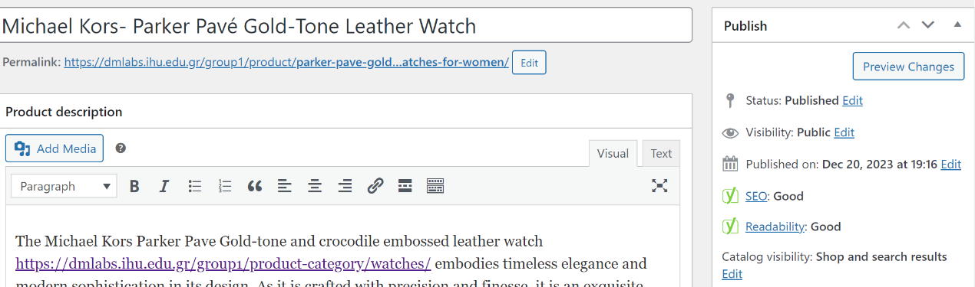
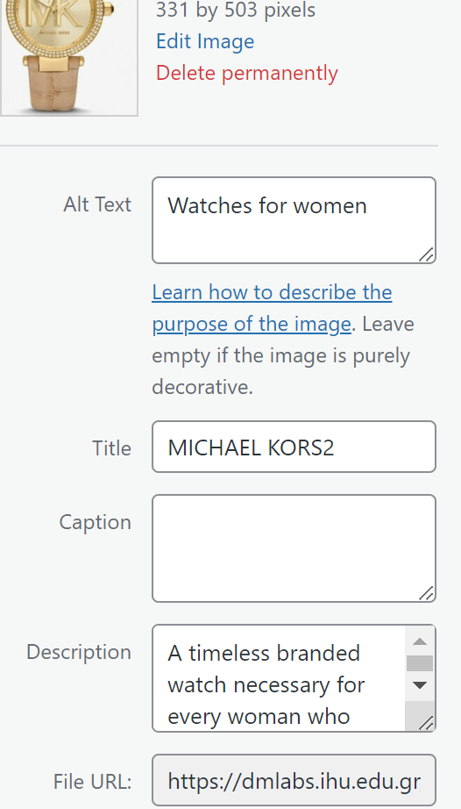
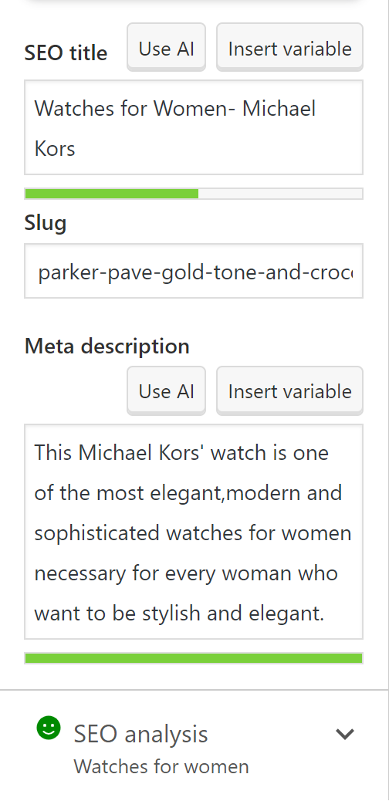
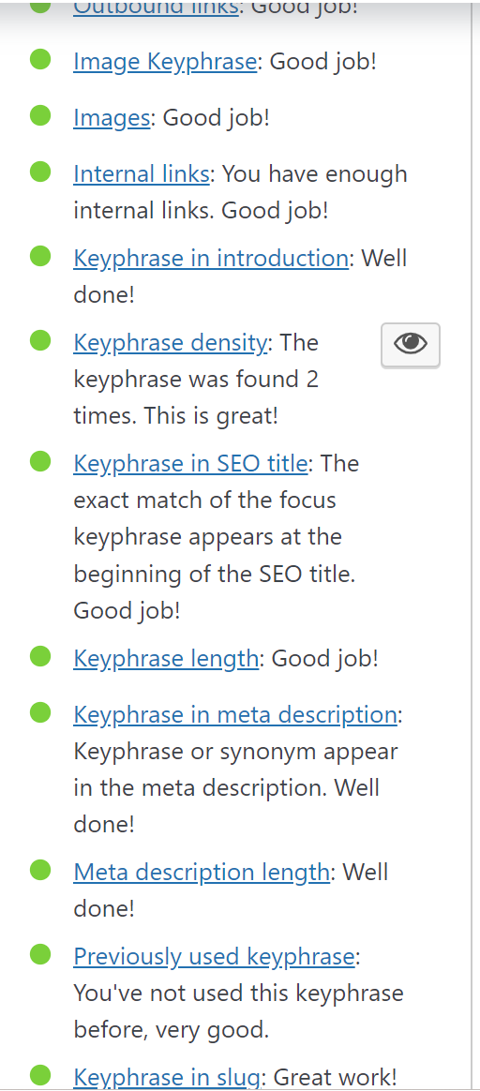
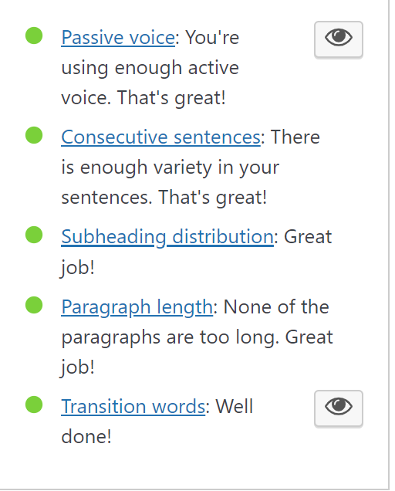
Image optimization
Readibility
SEO & READABILITY SCORE
Michael Kors- Parker Pavé Gold-Tone Leather Watch

Slide 15

PPC Campaign
Introduction
PPC campaigns have become an important part of online marketing strategies.
Goals: increase our audience, drive traffic and achieve marketing objectives in a cost-effective manner.
Selecting high quality, relevant keywords helped us reach the customers we wanted.
A marketing strategy may include both a Search and Display campaign in order to address different stages of the costumer journey.

Slide 16
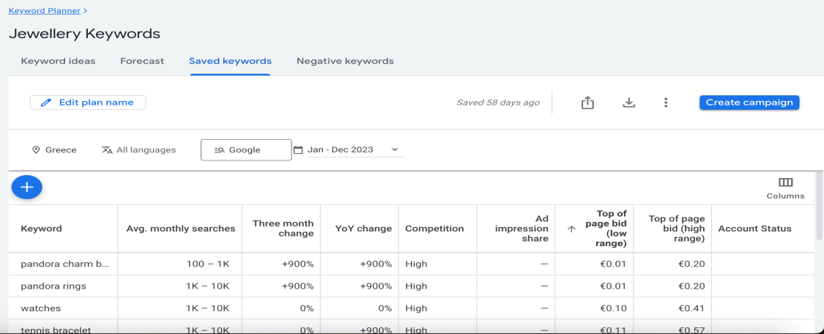
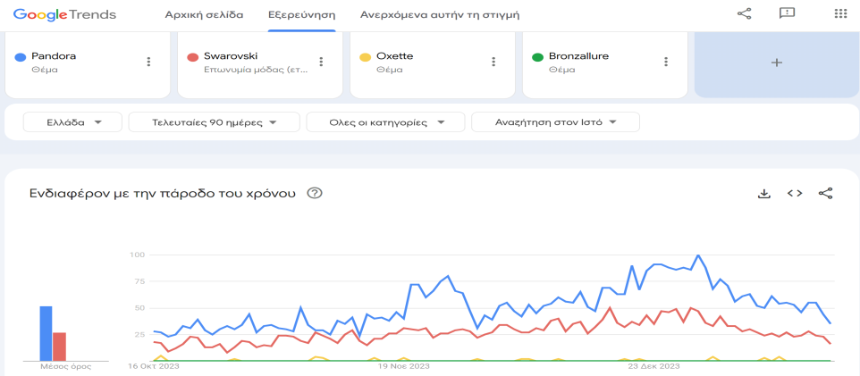
Steps of creating the PPC ads
Task 1.1 Find the products to promote in our campaign
The main selection criterion was sales and appeal. We used the tool of Google Ads Keyword Planner and identify that rings have a lot of searches.
Task 1.2 Find the brands for the campaign
Then we used the tool of Google Trends and identify that Pandora and Swarovski have high search volume and online presence.

Slide 17
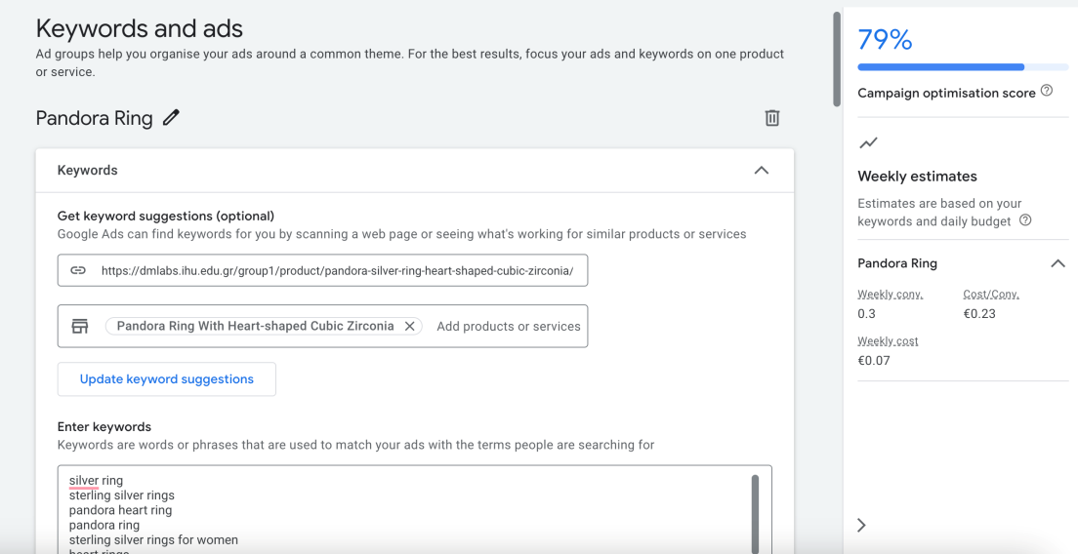
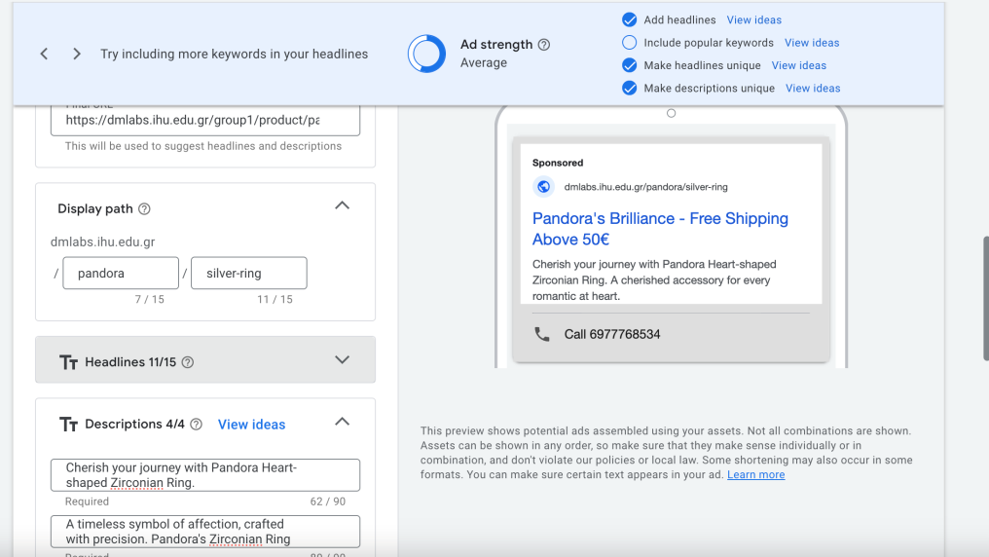
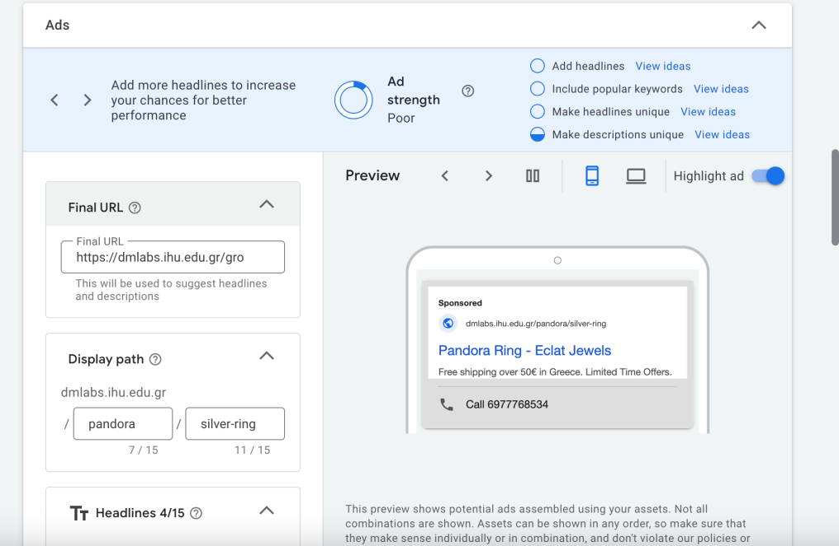
We created one Search campaign for sales with two ad groups. The products that we wanted to promote were : “The Pandora Ring with Heart-Shaped Cubic Zirconia”(1st ad group) and the “Swarovski trilogy ring”(2nd ad group).
Task 1.3: Creation of a Search campaign

Slide 18
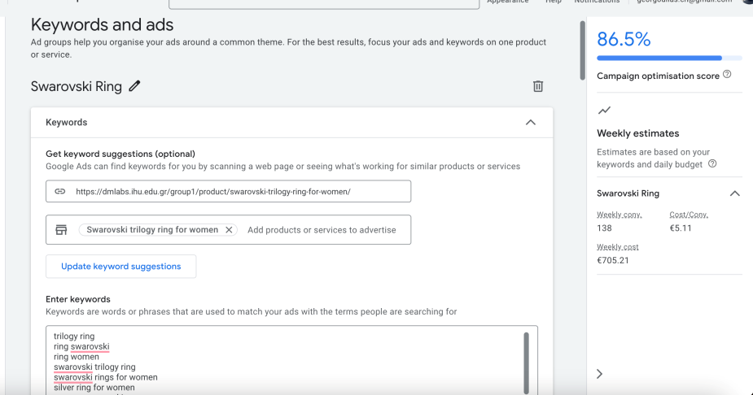
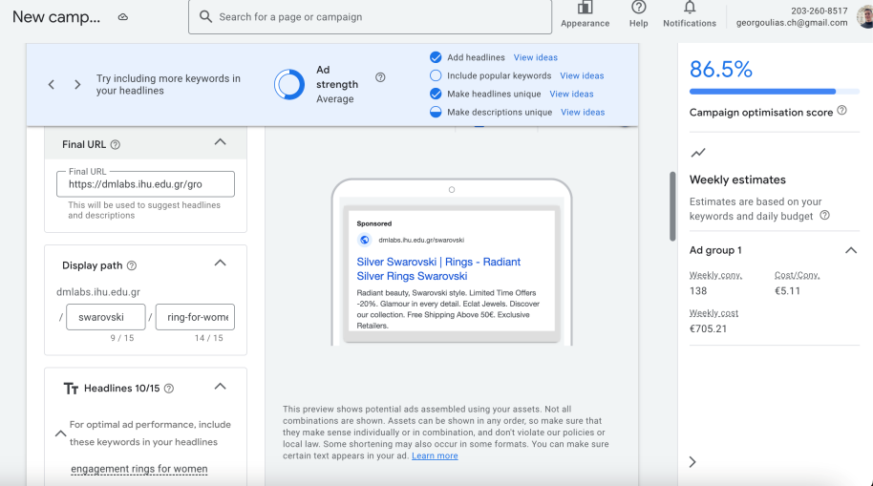
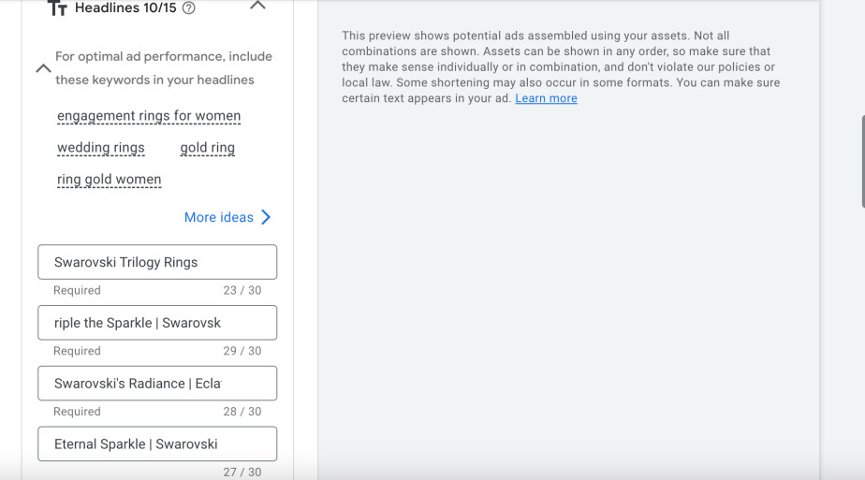
Task 1.3 PPC campaign for the
Swarovski trilogy ring (2nd ad group)

Slide 19
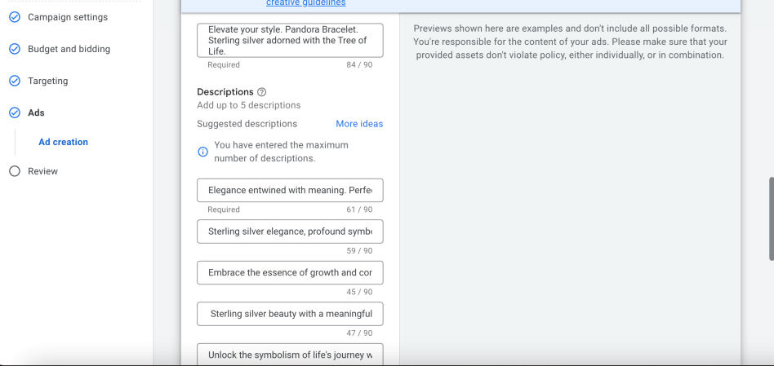
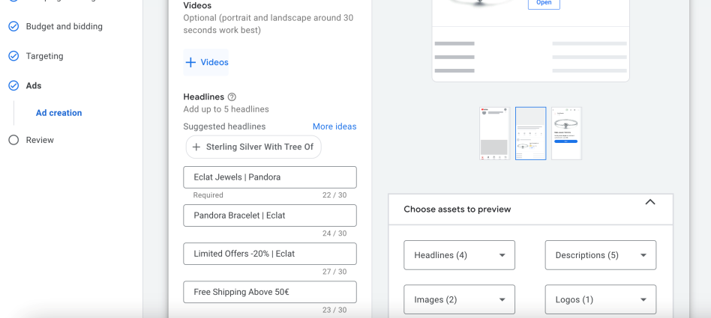

Task 1.4 Creation of a Display campaign
We created one display campaign for one of our most popular products the “Pandora bracelet sterling silver tree of life”

Slide 20
PPC STRATEGY PLAN
Define our goals (brand awareness, increase sales)
Understand the target audience( analyze demographics, online behavior , interests)
Keyword research (Google ads keyword planner)
Competitor analysis (find weaknesses and opportunities)
Budget allocation (set a realistic budget for our campaign)
Campaign structure (define the ad groups)
Ad creation (wrote headlines, descriptions, call to action)
Landing page optimization (landing pages linked to our ads are user-friendly)
Use analytics ( monitor our campaign’s performance)

Slide 21
SEO PERFORMANCE ANALYSIS FOR COMPETITORS’ WEBSITES
Based on our keyword research, SEO and competitor analysis we found that our basic competitors are: thebrandstore.gr, athinajewellers.gr, acrystalworld.gr, e-dazz.gr, antwnakakis.gr.
Through the Lighthouse Chrome extension we conduct SEO performance analysis about each of our competitors’ websites, so we can compare the results to ours.

Slide 22


Thebrandstore.gr
Athinajewellers.gr

Slide 23


Acrystalworld.gr
Antwnakakis.gr
E-dazz.gr

Slide 24

SEO AND PERFORMANCE TESTING FOR OUR WEBSITE
For our website we also conduct SEO and performance testing through the Lighthouse Chrome extension and we came up with the following results:
the percentage of our website’s performance is about 60%,
the percentage of accessibility is about 77%,
the percentage of best practices is about 100% and
the percentage of SEO is about 93%.

Slide 25



DESKTOP VS MOBILE PERFORMANCE SCORES
MOBILES
DESKTOP

Slide 26

PERFORMANCE
Largest Contentful Paint (LCP)
Cumulative Layout Shift (CLS)
LCP metric reports the render time of the largest image or text block visible within the viewport and shows the speed of the page’s loading is 3 seconds.
CLS is a user-centric metric for measuring visual stability and helps us quantify how often users experience unexpected layout shifts is 0.
Solutions for LCP
Optimization of Render-blocking resources
Use of smaller images through tools such as tinypng
Reduction of unused CSS and JavaScript

Slide 27
ACCESSIBILITY
Providing accessible names for buttons that appear in our page using attributes like aria-label or ensuring the button text is descriptive and meaningful
Upgrading links’ accessibility by using descriptive and meaningful text for links, avoiding generic phrases like "click here."
Reviewing Viewport Meta Tag by checking the <meta name="viewport"> tag and [user-scalable="no"] to ensure they are necessary, allowing users to zoom (if needed) and avoiding unnecessary restrictions
Enhancing the color contrast between background and foreground elements to meet accessibility standards and ensuring that the text is easily readable.

Slide 28
SEO
Upgrading link crawlability by using standard HTML <a> tags and avoiding elements that hinder crawlers, such as JavaScript to make the links crawlable.

Slide 29

MOBILE FRIENDLINESS
The viewport configured correctly
The page’s content fits device width
The text on the page is readable
The links and tap targets are sufficiently large and touch-friendly.

Slide 30
Behavioral Report
After gathering data for 30 days we decided to proceed with the creation of 3 visualised reports related to the overall performance to adjust our strategy.
30 Days Customer Monetisation Funnel (Table)
Paid VS Direct Traffic: Devices Distribution (Pie)
Paid VS Traffic: Fired Events Distribution (Table)

Slide 31

30 Days Customer Monetisation Funnel (Table)
Observations:
As we move deeper into the marketing funnel, we see that there's a quite equal diversification between the main basic events (Item Views, Add To Carts, Checkouts Initiated.) Male users are more by 30 % ( approx. ) from the females in most of the cases. With this insight we can re-consider our audience targeting for our PPC campaigns and allocate the budget accordingly. Eg. Spending more budget on males for cheaper results or pushing by bidding against for female audiences if we want to increase the visibility there.

Slide 32

Paid VS Direct Traffic: Devices Distribution (Pie)
Observations:
A very interesting insight here is that most of Paid traffic users compared with the Direct traffic ones are coming almost in double size from mobile devices !!90% in total for the paid.!! In Direct traffic data distribute quite differently as we see that desktop and mobile are sharing almost equally the whole pie. Considering this insight we can also adjust our device targeting on our PPC campaigns accordingly and choose to appear only on mobile devices to avoid bidding for minimum desktop traffic.

Slide 33

Paid VS Traffic: Fired Events Distribution (Table)
Observations:
By observing the table we can easily observe that the total events that were fired by Direct Traffic are almost 5 times larger than the Paid Traffic. Here the deep insights that we can get are in 2 specific events. (Session Start and New Recent Active User). On the contrary with the general % distribution of the events here, we see that the Paid traffic is just 2 times smaller than the Direct one in a total of 5 times larger events amount.
It seems that our PPC campaigns are targeting successfully new users compared to the Direct traffic that seems to have many already engaged users in these numbers.

